Slide 1
UK Shared Prosperity Fund Local Partnership Group
Clare Hatton
Director of Employment and Skills
West Midlands Combined Authority

Slide 2
Background
The UK Shared Prosperity Fund is a central pillar of the UK Government’s Levelling Up agenda. £2.6 billion funding for local investment with a primary goal to build pride in place and increase life chances across the UK.
3 key investment priorities:
Community and Place
Supporting Local Business
People and Skills

Slide 3
Investment Plan
Regional Allocation
50% will focus on ‘Regional Business Support’ - to provide support to local businesses.
50% prioritised individually by local authorities, particularly in terms of directing local place and communities, and people and skills provision
Local Allocation
Year 1 2022-2023 | Year 2 2023-2024 | Year 3 2024-25 | Total
£10,729,170 | £21,458,339 | £56,220,848 | £88,408,357
 | Year 1 (22/23) | Year 2 (23/24) | Year 3 (24/25) | Total
Birmingham | £2,118,950 | £4,237,899 | £1,620,971 | £17,460,145
Coventry | £66,101 | £1,320,203 | £3,458,931 | £5,439,235
Dudley | £545,674 | £1,091,348 | £2,859,332 | £4,496,354
Sandwell | £571,877 | £1,143,755 | £2,996,637 | £4,712,269
Solihull | £309,346 | £618,691 | £1,620,971 | £2,549,008
Walsall | £487,827 | £975,654 | £2,556,214 | £4,019,695
Wolverhampton | £456,226 | £912,452 | £2,390,625 | £3,759,303

Slide 4
Timeline
January 2023
Back to Back agreements and Year 1 Grant Schedules issued to Local Authorities
March 2023
First DLUHC progress report submitted
February 2023
Project Monitoring Visits commence
March 2023
Year 2 Grant allocations and Contract Schedule issued
April 2023
Year 1 actual deliverables and expenditure report for government

Slide 5
Reporting
UKSPF Performance reporting to Government - 3 monthly qualitative & 6 monthly quantitative return
1st return submitted March 2023
Progress summary to date and forecast of new projects
Actual and Forecast spend Year 1 including details of any projected underspend
WMCA Project Monitoring and Evaluation
Monthly deliverables and project-level updates
Quarterly reporting (with expenditure signed off by LA S151)
financial spend
programme wide updates
risk assessments by pillar
case studies
due diligence
Communication & marketing
WMCA will from time-to-time sample expenditure and deliverable evidence based on a project and programme basis.

Slide 6
Year 1 Position
 | Spend | Performance to Outputs | RAG Rating
Birmingham | On track | On track | Green
Dudley | On track | On track | Green
Coventry | At risk | At risk (low levels forecast on original Investment Plan) | Red*
Sandwell | On track | On track | Green
Solihull | On track | Some to move from Yr 1 to Yr 2 | Amber**
Walsall | On track | On track | Green
Wolverhampton | On track | On track | Green
* Coventry City Council are currently rated RED, this is due to an underspend in year 1 – credible plan will be submitted
** Solihull MBC are currently rated as AMBER due to the movement of some outputs & outcomes from Year 1 projects into Year 2. Whilst not seen as a programme-level concern, it is noted that this will impact Year 1 performance.

Slide 7
Credible Plan
A Credible plan will be submitted as part of the end of 2022-23 Financial Year report, due at the end of April 2023, in line with DLUHC guidance for Year 1 underspend to be reprofiled.
Coventry City Council reprofile £628,495.
Timing of internal cabinet approval of the SPF Grant Agreement meant that whilst procurement activity commenced in February, they were unable to spend year 1 within required timelines.
Regional Business Activity reprofile £5.1m
In line with the recent WMFD approval WMCA will submit a credible plan for year 1 Business Support funding £5,150,002. The WMCA has its rational and evidence in place to support this.

Slide 8
Year 2 – Local Authority
Project and programme submissions have been received from Local Authorities providing detailed forecast to enable oversight of deliverable and financial profiles across the programme
Local allocations will be grant funded to Local Authorities including delivery of the hub and spoke business support model and programmes.
Community and Place projects
Improving the spaces for residents including town centre and high street assets, lighting and signage, leisure sports and play facilities and green spaces.
Support for the Voluntary and Community Sector with projects focussed on capacity building; improvements to facilities and community spaces, reducing digital exclusion and encouraging community engagement through volunteering or activities.
Working with residents to address anti-social behaviour, developing safer neighbourhoods and support for households around a range of cost-of living measures.
Working with local organisations to increase the range of creative arts, cultural and heritage activities in local neighbourhoods, increasing engagement and participation.

Slide 9
Year 2 - WMCA
Evaluation
Commissioning evaluation of Business Support
Reporting Platform
Developing platform for UKSPF reporting
LA Workshop
UKSPF project leads reviewing Output and Outcome definitions
People and Skills
Working with LA officers on UKSPF priorities in line with the wider skills landscape

Slide 10
Local
Authority
Update

Slide 11
Wolverhampton’s Communities and Place Interventions
Communities
Focus on place based initiatives that support local priorities including financial wellbeing, digital inclusion and protect VCS capacity around employment & skills
In 2022/23, funding activities to address the cost of living crisis including community grants for Community Shops, Cost of Living Hub in the city centre & community public WiFi.
Call for Community Grants issued closing 28 March for activities in 2023/24 to fund VCS led activities that support key local priorities.
Vibrant High Streets
2022/23 focused on quick wins including public realm improvements to physical spaces in high streets
2023/24 activities will also include animation activities and events that increases footfall and visitor numbers involving local artists and creative organisations.
UK SPF has been used to part-fund fit out costs for a new enterprise hub iGNITE in 2022/23
wolverhampton.gov.uk

Slide 12
Walsall UKSPF 2022-23 Update
Funding Allocation: Year 1 2022/23 Capital £100,000 Revenue £387,827 Management Fee £55,000 TOTAL £542,827 (spend on track)
Walsall’s approach:
• Vibrant places to live, work and visit: improvements to town centres, development of local nature reserves and green spaces, heritage and cultural programmes to attract footfall, and feasibility work to inform future planning.
• Safer cohesive communities: interventions to design out crime and reduce anti-social behaviour, support for impactful volunteering and social action projects to develop human capital in local places, improvements to existing community and neighbourhood infrastructure projects and investment in VCS capacity building.
• Sustainable neighbourhoods: support for Council and community decarbonisation programmes, including cost of living and energy efficiency training and advice for families, organisations and businesses.
Recruitment underway for UKSPF Programme Officer &
Finance Monitoring Officer

Slide 13
Year 1 Update - Communities and Place
Solihull UKSPF Delivery Plan agreed by Full Cabinet 9th March 2023
Year 1 Delivery:
Investment in Family Hubs and Community Buildings
Kingshurst village centre re-development
Groundworks
Community capacity building
Cultural Hub
Entrepreneurship
Cultural events
Digital Hub
Town centre improvements
Marketing campaigns
Seasonal events
Local markets

Slide 14
Sandwell MBC – Kelly Harris
Communities and Place (Capital)
Capital funding used for Green Spaces project to improve education and training facilities in Sandwell
Communities and Place (VCS)
Community engagement, volunteering and breaking down barriers
Delivery of 8 community events across the borough
Business Support
Entrepreneurship and Business Start-up advice and support workshops delivered over 4 weeks to 44 residents
Enterprise Support and Business Account Management
190 SME’s given membership to BC Chamber of Commerce for ‘wraparound support’

Slide 15
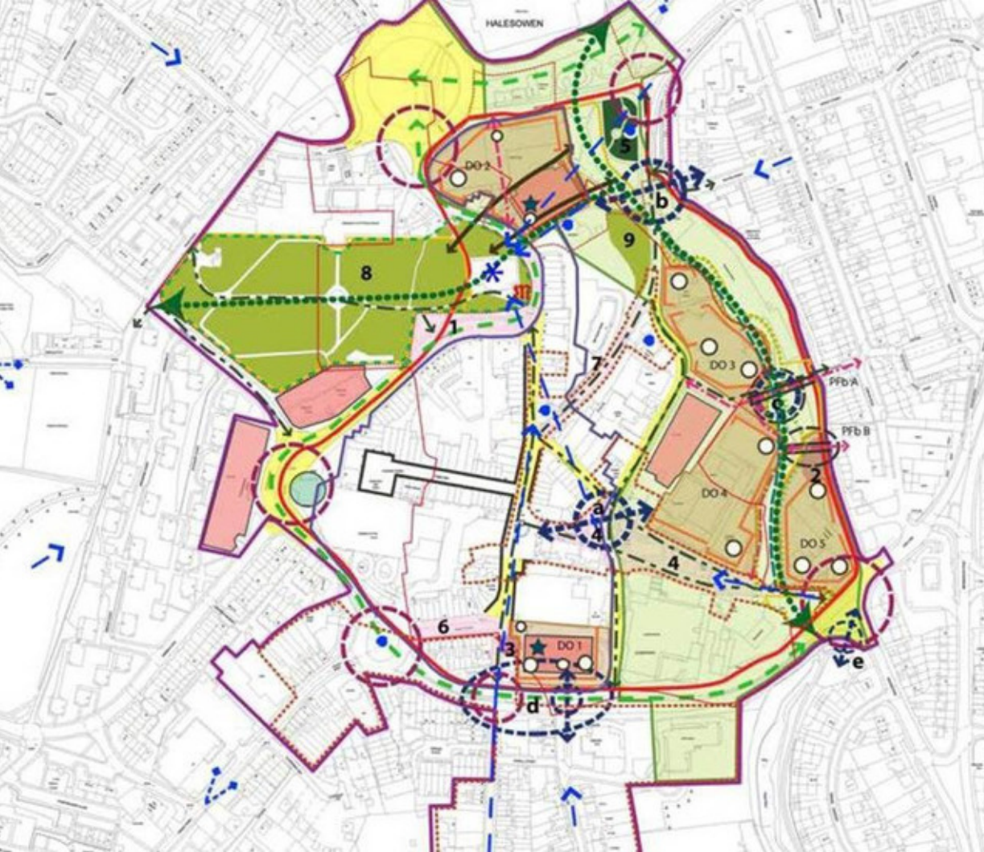
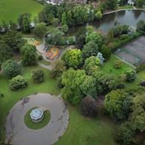
Dudley UKPSF Year 1 Activity
Masterplan and Feasibility Studies to inform year 2 and 3 activity
Stourbridge Town Centre and Shell Corner masterplans
Master planning and design works aligned to the councils Levelling Up Fund programme and projects.
Dudley Town Centre and Stourbridge Town Centre feasibility – how can UKSPF funding be used to support the development of business and/or community groups to drive forward improvements to the respective Town Centre’s.
Enhancements to local parks and green spaces
Stevens Park, Quarry Bank – resurfacing of the skate park and play area and installation of knee rails
Buffery Park, Dudley – improvements and resurfacing of pathways and introduction of bollards and knee rails
Netherton Park – improvements and resurfacing of pathways
Priory Park, Dudley – replacement and refurbishment of benches
School Drive, Amblecote – improvements to the play area
https://www.dudley.gov.uk/news/first-tranche-of-multi-million-funding-boosts-town-centres-and-parks/

Slide 16
Coventry City Council
Job Shop
Central Hub
Disability and Health Conditions
-LD/ASD
-MH – Working with MH support providers providing specialist MH Job Coaches (for (depression/anxiety etc)
50+ EA & Unemployed
-Focused on hotspot areas
-Working with specialist VCS providers
-Includes peer support, group work, redundancy support
Communities Work
-Outreach Job Coaches working closely with VCS + health/LA and other services
-Focused on most deprived areas including deprived LSOA’s within more affluent wards
EA/ low paid women
Focused on wards with largest gender gaps
-Working with specialist VCS providers
-Focus on career progression, in work upskilling, accessing childcare, removing barriers
Substance Misuse (especially alcohol)
-Working with CGL and other specialist VCS providers
-Specialist Job Coaches focus on removing barriers
-Provides employment support volume
-Hosts partners VCS/DWP/NCS etc
-Leading on recruitment business support
-Includes vacancy support, events, job shaping, advice etc
Notes:
EA = Economically Inactive

Slide 17
Birmingham City Council – Year 1 projects
Total: £2.1million
Retrospective spend used in Year 1
Ward End Park & Lakeside Renewal (£827K)– The Dolphin Centre, a community hub, is being extended and upgraded. The floor space will be increased by 106m2 and energy efficiency measures will be installed to improve the building’s thermal performance (triple glazing, Solar PV’s, and a new boiler). 6 hectares of the park and lake will receive ecological improvements to promote wildlife and biodiversity along with the establishment of new heathland.
Interventions: E3 and E4
Moseley Road Baths Improvements (£309K) – A Grade II listed building received necessary restoration works to its façade and the old manager’s flat and boardroom have been renovated to create additional space for staff and visitors. The site is the only Grade II listed swimming baths operational outside of London, and one of only six Grade II listed baths in the UK.
Interventions: E1 and E4
Abbeyfield Playing Field (£278K) – The site has benefitted from the reconstruction of a new multi-use games court as well as a new grass pitch on a previous demolition site. Located next to a disused youth club, plans are to use these upgrades to reopen this club and create a community hub.
Interventions: E10
Perry Barr Public Realm Improvements (£505K) – Upgrades to public space on the old BCU site in Perry Barr. This particular project focused on creating green spaces and play areas for the community around new homes built in the area.
Interventions: E1
Working Together in Birmingham's Neighbourhoods (£200K) - Delivering place-based holistic interventions to realise the City Councils Working Together in Birmingham's Neighbourhoods policy. Local groups are to develop and deliver action plans that create sustainable, safer, stronger neighbourhoods. By empowering community voices and anchor organisations to co-deliver this change, citizens feel they have a stake and say in what happens in their local neighbourhood, and the agency to get involved and take action with their community to create local places they are proud of. Focus in Year 1 will be to support and strengthen community infrastructure across Birmingham to ensure that neighbourhoods can survive the cost of living crisis and ensure future delivery of activities, and energy efficiency measures.
Interventions: E2

